Slide 1
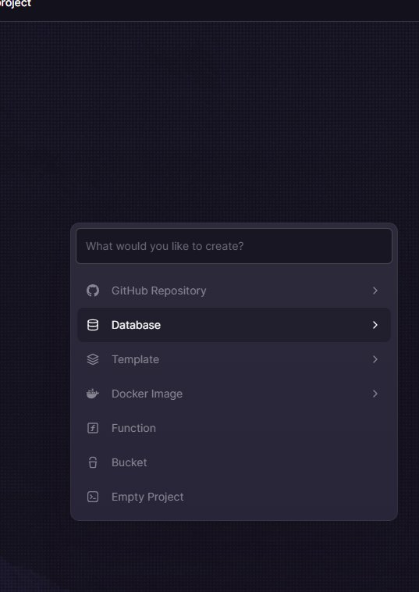
EN
WEEK 06
</>
Final Project & Certificate
Build, present and celebrate your Python journey
By the end of this lesson you will be able to:
○ Plan and build a complete Python project from scratch
○ Apply variables, loops, functions, files and modules
○ Present your project and earn your certificate
codencode.my
Python for Beginners • Week 06 — Final Project & Certificate
EN
01

Slide 2
What You've Learned — 5-Week Recap
W1
Variables & Logic
W2
Loops & Functions
Variables, data types (int/float/str/bool), input(), f-strings, casting, if/elif/else, comparisons
for loops, while loops, def, return vs print, lists, list comprehensions, enumerate, zip
W3
Files & Errors
W4+5
Dicts, Modules & Apps
open() read/write/append, with statement, try/except/finally, CSV files, input validation
Dictionaries, Contact Book project, random, datetime, math, os, pip, building your own modules
codencode.my
Python for Beginners • Week 06 — Final Project & Certificate
EN
02

Slide 3
Final Project — Choose Your App
📖 Pick one of these 4 ideas
project_checklist.py
Choose the project that excites you most. All four use the same Python skills — the difference is just the problem you're solving.
🗒️ Option A: Personal Diary App
Save dated entries to a file, list by date, search keywords
🏪 Option B: Simple Shop System
Add products with prices, calculate totals, apply discounts
📊 Option C: Student Score Tracker
Track scores over multiple tests, show average and trend
🎲 Option D: Text Adventure Game
Rooms, items, random events, save/load progress
# Your project must include ALL of these:
# ✅ At least 3 functions
# ✅ At least 1 loop (for or while)
# ✅ At least 1 if/elif/else
# ✅ File save and load
# ✅ At least 1 try/except
# ✅ At least 1 module (random or datetime)
# ✅ A menu or main loop
# ✅ Clean, commented code
# Bonus marks for:
# ⭐ Input validation on all inputs
# ⭐ Extra feature not in the brief
# ⭐ Particularly clean code structure
codencode.my
Python for Beginners • Week 06 — Final Project & Certificate
EN
03

Slide 4
Project Template — Start Here
my_project.py
"""
Project Title: ________________________
Author : ________________________
Date : ________________________
Description : ________________________
"""
import random
from datetime import datetime
import os
# ── Constants ─────────────────────────────────
DATA_FILE = "data.csv"
# ── Data ──────────────────────────────────────
data = []
# ── Functions ─────────────────────────────────
def show_menu():
pass # TODO: implement
def add_item():
pass # TODO: implement
def list_items():
pass # TODO: implement
def save_data():
pass # TODO: implement
def load_data():
pass # TODO: implement
# ── Main ──────────────────────────────────────
if __name__ == "__main__":
data = load_data()
while True:
choice = show_menu()
# TODO: handle choices
💡 What this does:
Start with this template. Fill in the docstring first — explain what your program does in plain English before writing any code. if __name__ == '__main__': ensures the code only runs when you execute this file directly.
codencode.my
Python for Beginners • Week 06 — Final Project & Certificate
EN
04

Slide 5
Code Quality — Writing Clean Python
📖 Habits that make you a real developer
clean_code.py
Good code is not just code that works — it's code that others (and future-you) can read.
Code quality checklist:
○ Every function has a clear, one-thing purpose
○ Variable names are descriptive
○ Comments explain WHY, not WHAT
○ No duplicate code — use functions
○ Handle edge cases (empty list, bad input)
○ Consistent indentation (4 spaces)
○ Docstrings for each function
A program that works but is unreadable is half-finished.
# ❌ Bad code
def f(x,y):
a=x+y
if a>100:
print("big")
else:
print("small")
# ✅ Clean code
def categorise_total(price, tax):
"""Return size category based on total cost."""
total = price + tax
if total > 100:
return "expensive"
return "affordable"
result = categorise_total(85, 20)
print("This item is:", result)
codencode.my
Python for Beginners • Week 06 — Final Project & Certificate
EN
05

Slide 6
Sample Project — Personal Diary App
diary_app.py
from datetime import datetime
def add_entry(diary):
"""Add a new timestamped diary entry."""
text = input("Dear diary... ").strip()
if not text:
print("Entry cannot be empty.")
return
date = datetime.now().strftime("%Y-%m-%d %H:%M")
diary.append({"date": date, "text": text})
print("✅ Entry saved!")
def view_entries(diary):
"""Display all diary entries."""
if not diary:
print("No entries yet.")
return
for e in diary:
print(f"
[{e['date']}]")
print(f" {e['text']}")
def save_diary(diary, filename="diary.txt"):
"""Save diary entries to file."""
with open(filename,"w") as f:
for e in diary:
f.write(f"{e['date']}|{e['text']}
")
print(f"✅ {len(diary)} entries saved.")
💡 What this does:
This complete diary app in ~30 lines shows real structure: docstrings, input validation, combined modules and file I/O. Notice how each function does exactly ONE thing.
codencode.my
Python for Beginners • Week 06 — Final Project & Certificate
EN
06

Slide 7
Sample Project — Shop System
shop.py
def add_product(inventory):
"""Add a product to inventory."""
name = input("Product name: ").strip()
price = float(input("Price (RM): "))
qty = int(input("Quantity: "))
inventory.append({"name":name,"price":price,"qty":qty})
print(f"✅ {name} added.")
def view_inventory(inventory):
"""Display all products with totals."""
print(f"
{'Item':<15} {'Price':>8} {'Qty':>5} {'Value':>10}")
print("─" * 42)
total_value = 0
for item in inventory:
value = item["price"] * item["qty"]
total_value += value
print(f"{item['name']:<15} RM {item['price']:>6.2f}"
f" {item['qty']:>5} RM {value:>8.2f}")
print("─" * 42)
print(f"{'Total value':>29} RM {total_value:>8.2f}")
💡 What this does:
Format codes in f-strings: {name:<15} left-aligns in 15 chars, {price:>6.2f} right-aligns a float with 2 decimal places in 6 chars. This creates clean, aligned table output.
codencode.my
Python for Beginners • Week 06 — Final Project & Certificate
EN
07

Slide 8
Debugging — Finding & Fixing Bugs
📖 Every developer debugs — learn to do it well
debugging.py
Bugs are normal. The skill is finding them quickly.
Debugging techniques:
○ Read the error message — it tells you line number and type
○ Add print() statements to trace values
○ Test each function independently
○ Use a small, simple input to reproduce the bug
○ Comment out code to narrow down the problem
Common bugs:
○ NameError — variable doesn't exist / typo
○ IndexError — list index too large
○ KeyError — dict key doesn't exist
○ IndentationError — wrong indentation level
# Debugging with print()
def calculate_avg(scores):
print(f"DEBUG: scores = {scores}") # ← add this
print(f"DEBUG: len = {len(scores)}")
total = sum(scores)
print(f"DEBUG: total = {total}")
return total / len(scores)
# Test with simple data first
test = [80, 90, 70]
result = calculate_avg(test)
print("Average:", result)
# Then test edge cases
calculate_avg([]) # ← what happens?
codencode.my
Python for Beginners • Week 06 — Final Project & Certificate
EN
08

Slide 9
Making Your Program Robust
robust.py
def safe_input_float(prompt, min_val=0):
"""Keep asking until a valid float >= min_val is entered."""
while True:
try:
value = float(input(prompt))
if value < min_val:
print(f"Value must be >= {min_val}")
continue
return value
except ValueError:
print("Please enter a number (e.g. 12.5)")
def safe_input_choice(prompt, valid):
"""Keep asking until a valid menu choice is entered."""
while True:
choice = input(prompt).strip()
if choice in valid:
return choice
print(f"Please enter one of: {', '.join(valid)}")
# Usage
price = safe_input_float("Price (RM): ", 0)
choice = safe_input_choice("1-Add 2-List 3-Quit: ", ["1","2","3"])
💡 What this does:
Helper input functions are a best practice. Define them once, reuse everywhere. safe_input_float() handles invalid text AND out-of-range values. safe_input_choice() validates menu selections.
codencode.my
Python for Beginners • Week 06 — Final Project & Certificate
EN
09

Slide 10
Presentation Day — What to Cover
01
What your app does
02
How you built it
1 minute. Explain the problem your app solves. Who would use it? What does it do? A quick live demo of the key feature.
Show your code structure. Name 2 functions you're proud of. Explain one challenge you faced and how you solved it.
03
What you learned
04
What's next
Which week's content did you use most? What was hardest? What would you add if you had more time?
Python opens doors to web apps, AI, data science, automation. Which direction interests you most? ML Fundamentals is your next step!
codencode.my
Python for Beginners • Week 06 — Final Project & Certificate
EN
10

Slide 11
🧠 Quiz Time!
Q:
Which of these is the BEST reason to use a function instead of writing the same code twice?
A
Functions make your program run faster
B
Functions are required by Python — you cannot write code outside them
C
If the logic needs to change, you only update it in one place instead of many
D
Functions automatically handle errors so you don't need try/except
codencode.my
Python for Beginners • Week 06 — Final Project & Certificate
EN
11

Slide 12
What Comes After Python Basics?
next_steps.py
# 🌐 Web Development
# pip install flask
from flask import Flask
app = Flask(__name__)
@app.route("/")
def home():
return "<h1>Hello from Python!</h1>"
# 📊 Data Science
# pip install pandas numpy matplotlib
import pandas as pd
df = pd.read_csv("scores.csv")
print(df.describe())
# 🤖 Machine Learning
# pip install scikit-learn
from sklearn.linear_model import LinearRegression
model = LinearRegression()
# model.fit(X_train, y_train)
# 🔧 Automation
import os, shutil
# Move, rename, batch process files
# All of these are just Python +
# the same skills you already have!
💡 What this does:
Everything you've learned — variables, loops, functions, files, modules — is the foundation. Flask, pandas, scikit-learn are just more modules. The syntax is the same. The concepts are the same.
codencode.my
Python for Beginners • Week 06 — Final Project & Certificate
EN
12

Slide 13
⌨️ Try It Yourself
📋 Final Project Submission
🏆 XP Reward
1. Choose your project idea (Diary / Shop / Score Tracker / Adventure Game)
2. Start with the project template — fill in the docstring and plan your functions
3. Build one function at a time, testing each before moving on
4. Make sure ALL checklist items are ticked: 3 functions, loop, file, try/except, module
5. Comment your code and clean up variable names
6. Prepare a 3-minute presentation: what it does, how you built it, what you learned
200 XP
⏱ Time Limit
90 min
Expected output:
── Your Final Project ──
Running and complete
All checklist items ticked
Presented to the class
🎓 Certificate earned!
codencode.my
Python for Beginners • Week 06 — Final Project & Certificate
EN
13

Slide 14
⌨️ Try It Yourself
📋 Peer Review Challenge
🏆 XP Reward
1. Exchange your .py file with a classmate
2. Try to run their program — does it work without any instructions from them?
3. Check: is the code readable? Are variable names clear? Are functions well-named?
4. Write 2 things you liked about their code and 1 suggestion to improve it
5. Discuss feedback with each other — this is how professional code reviews work
50 XP
⏱ Time Limit
20 min
Expected output:
✅ Ran without errors
✅ Readable code
💬 Feedback given
💬 Feedback received
🤝 Code review complete
codencode.my
Python for Beginners • Week 06 — Final Project & Certificate
EN
14

Slide 15
Lesson Summary
✅ What we learned today
🔍 Next Week
○ You can now write real Python programs from scratch
ML Fundamentals (if continuing)
Build on your Python skills to explore data, statistics, machine learning models and neural networks with real datasets.
○ Variables, loops, functions, files, modules — all working together
○ Clean code matters as much as working code
○ Planning before coding saves more time than it costs
○ You have earned your Python for Beginners certificate 🎓
📝 This Week's Assignment
200 XP
Submit your final project .py file + a short README explaining what it does. Prepare your 3-minute presentation for next session. 200 XP on completion.
codencode.my
Python for Beginners • Week 06 — Final Project & Certificate
EN
15

